Slide 1
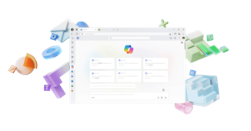
















Insert Partner
Logo Here
Your plan just got
smarter with Copilot.
AI built for work.
      Get more value with one, simplified solution.
      All Microsoft 365 desktop apps and cloud services, now with built-in AI. Save time and money by bringing together your productivity apps, AI and advanced security in one bundle. No need to manage separate tools.
Best-in-class productivity
AI built for work
+ more
Microsoft 365 Business Plan
(Basic, Standard, Premium)
Microsoft 365 Copilot Business
Limited time offer!
Your all-in-one AI solution for only $10 more per user/month
Microsoft 365 Business Premium + Copilot Business
Purchase requirements: Qualified purchase of 10 to 300 licenses required during the promotion period of December 1, 2025 – March 31, 2026.
Ready to get started?
Contact the <Partner Name> team.
user.name@company.com
company.com
linkedin.com/username
© Microsoft 2025. All rights reserved.
MICROSOFT MAKES NO WARRANTIES, EXPRESS OR IMPLIED, IN THIS SUMMARY

